Slide 1
HB 2017 Transit Advisory Committee
January 19, 2018
Notes:
Neil Introduction

Slide 2
Meeting Agenda
Welcome and Introductions
Action Items from Last Meeting
  Questions from Dec. 12th meeting
  Review & Approve Revised Guiding Statement
  Review & Approve Low Income Fare
FY19 Service Proposal
Regional Coordination
Public Comment

Slide 3
Questions from Dec. 12th
Budget: where does electric bus purchases fall in TriMet’s overall bus purchasing program?
  To be discussed when we talk about the capital program (Feb. 23rd)
Commute Trip Patterns
  Consultant making maps showing the commute trip patterns for communities outside the TriMet district
  TriMet has maps showing the commute trip patterns for communities inside the TriMet district
  Maps will be available for Regional Coordination Technical Committee on Jan. 26th and for the Advisory Committee when we begin to discuss service improvements.

Slide 4
Advisory Committee Guiding Statement
✓
The Public Transportation Improvement Plan will guide TriMet on how to spend State Transportation Improvement Funds (STIF) for the following purposes:
expansion of existing and creation of new transit services (including last mile services), except for light rail, with consideration for communities with a high percentage of low-income households and responsible contracting and workforce utilization,
programs to reduce transit fares for communities with a high percentage of low-income households,
procurement of buses powered by natural gas or electricity,
capital projects required for the creation, expansion and improvement of transit services, including projects intended to improve speed and reliability, with consideration for communities with a high percentage of low-income households and responsible contracting and workforce utilization,
expansion of existing/creation of new transit services in communities outside the TriMet service district, but inside in Clackamas, Multnomah, and Washington counties, and
regional coordination/reduction of fragmentation between TriMet and communities outside the TriMet service district, but inside Clackamas, Multnomah, and Washington counties.

Slide 5
Low Income Fare
✓
HB 2017: programs to reduce fares for public transportation for communities with a high percentage of low-income households
Low Income Fare Taskforce Recommendations:
Recommended eligibility of up to 200% FPL
Recommended a program subsidy at 50% off of an Adult day pass and 70% off of an Adult monthly pass (equivalent to Honored Citizen and Youth Fare structures)
Approximately $12.3 million per year; supporting up to 45,000 riders
TriMet’s commitment that any new resources would be prioritized to fund the new LIF Program and service increases
Funds will not be received until early 2019; however, TriMet’s goal is to launch in July 2018

Slide 6
FY19 Service Proposal
Why talk about this now?
Where did it come from?
Guidelines
Balancing objectives

Slide 7
FY19 Service Proposal Timeline
July 2018, HB2017 tax effective
September 2017-January 2018 Initial Proposal outreach
January 2018-February 2018 Second round of outreach
March 2018 TriMet Board of Directors first reading
April 2018 TriMet Board of Directors, adoption
May-August 2018 Operational readiness
September 2018 Service begins

Slide 8
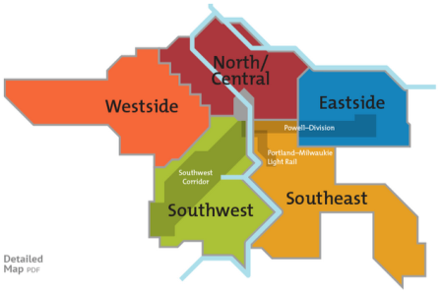
Service Enhancement Plans

Slide 9
Existing Requests
Frequent Service more frequent
New Frequent Service bus lines
Route changes or extensions
New bus lines
Employment access

Slide 10

Balancing Objectives
Safety & Equity
Capital
Service Hours
Ridership based
Geographic Coverage
Frequency
Span of Service
Lifeline coverage
Schedule Reliability
Notes:
-So, as we go through the service planning process, we are constantly weighing and trying to find the appropriate balance of investments that provide the greatest service to the largest number of people.
-Safety and Equity are factors that overarch all of these other balancing considerations, but within that context, we must balance:
-Capital investments vs. Service Hours, do we bond for buses, when do we do repairs and upgrades to maintenance facilities, for example.
-Geographic coverage vs. fare box recovery. As we pioneer service in suburban areas our fare box recovery will likely not be as strong as it would be if we added service on our most popular routes.
-Span of service – evenings, weekends, early mornings is important for some customers, and can cost less because it may not require new buses -- but typically has a lower farebox than additional frequent service, which may move more people.
-Schedule reliability is important but it requires adding more runs as congestion grows. Should that be a priority over adding basic service in areas with very little or no current service?

Slide 11
Service Planning
Service Plan
Demand
Connections
Productivity
Equity
Growth
Operations
Bus Availability
Notes:
Equity - TriMet’s services and business opportunities are open to everyone in our community. TriMet operates with fairness and equity for all. TriMet complies with Title VI of the Civil Rights Act, and also strives to ensure that the decisions of where and when to serve are made through an equity lens, considering the needs of low-income populations, people of color, people with disabilities, and other communities of concern. Equity is a lens through which the other following considerations should be considered.
Demand - Service should respond to changes in demand for mobility and access via transit.
Productivity – Productivity (measured in boarding rides per vehicle hour) measures the cost-effectiveness of the service provided. Productivity should be understood in the context of the need to provide service across the district as well as challenges such as last-mile connections or partnering with other agencies or service providers to meet the needs of specific areas with comparatively lower demand.
Connections - Connections to jobs, to school, and other high priority places for communities. These can include key locations such as job centers, schools, colleges, training centers, and neighborhood housing.
Growth – Growth in population and employment in various parts of the region should help inform service decisions and service should support the needs of this growth.

Slide 12
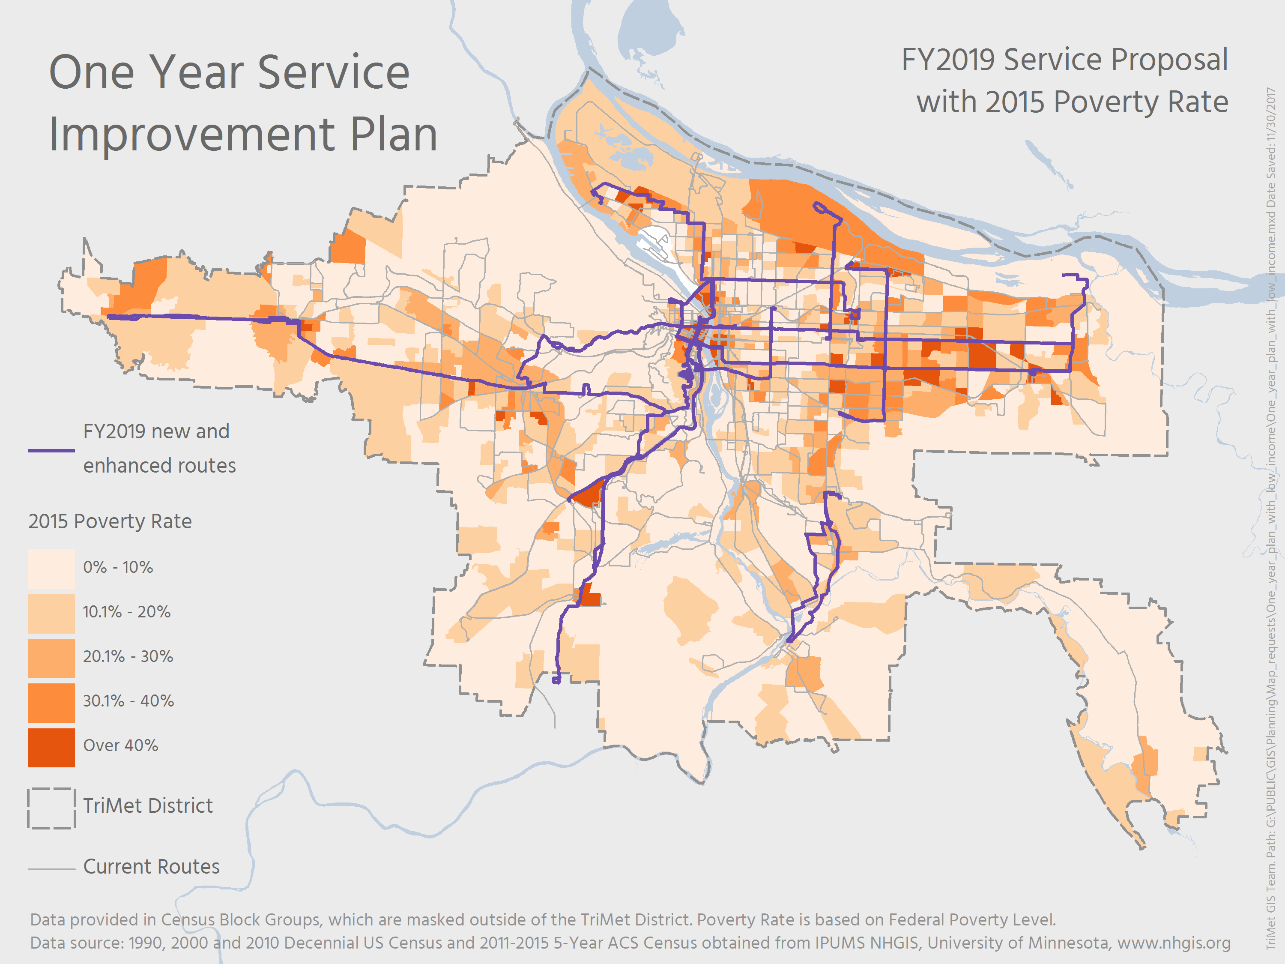

Slide 13
FY19 Service Proposal
✓
24 hour service on lines 20-Burnside/Stark and 57-TV Hwy. New bus service to the Portland Airport when Red Line isn’t running
Increased frequency on 3 bus lines (20,73-122nd,81-Kane Rd/257th)
Route change to 2 bus lines (24-Fremont,79-Clackamas/Oregon City)
Increased span of service (61-Marquam Hill/Beaverton,64-Marquam Hill/Tigard,66-Marquam Hill/Hollywood,68-Marquam Hill/Collins Circle, 96-Tualatin/I-5)
One new bus line (Clackamas County on Webster Road)

Slide 14
Regional Coordination
Regional coordination and reduction of fragmentation between TriMet and communities outside the TriMet service district, but inside Clackamas, Multnomah, and Washington counties.
Last mile service to difficult to serve areas due to:
  Street network
  Low density areas

Slide 15
Regional Coordination
Reducing Fragmentation
Rural Shuttle
Last Mile Shuttle
TriMet Network
Outside TriMet District
Inside/Outside TriMet Connection: Reduce Fragmentation
Inside TriMet District

Slide 16
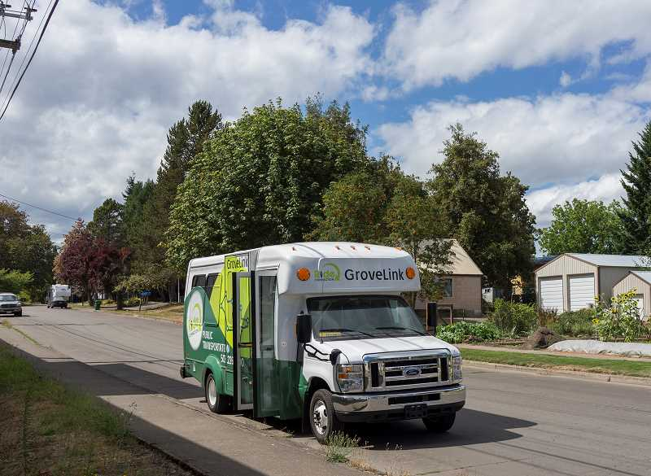
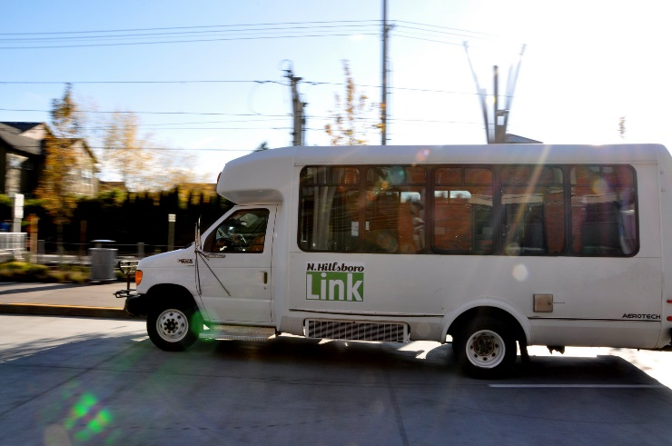
Regional Coordination
Existing last mile shuttles:
GroveLink – Forest Grove
N. Hillsboro Shuttle – N. Hillsboro Industrial Area
Tualatin Shuttle – Tualatin Industrial Area
PCC – late night shuttle to Swan Island

Slide 17
Regional Coordination
✓
Set aside funding for shuttles to:
  Serve difficult to serve areas
  Connect with out of district communities
$2.0 mil
Review at the end of the process

Slide 18
Topics for Next Meeting
Dependencies for new service (mechanics, buses, garages, etc.)
Maximum “ramp up” of new service
Other investments:
  Electric Bus
  Articulated Bus
  System Capital
  Enhanced Transit

Slide 19
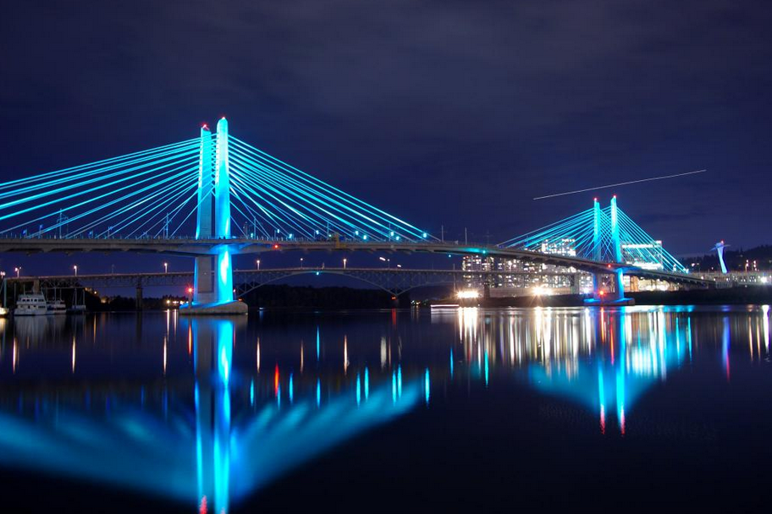
Public Comment

